Slide 1
COUNTERS
Presented:Burak ELHAMAN

Slide 2
Titles
What is counter
Where we use counters
Counter types
First project
Second project
Conclusion

Slide 3
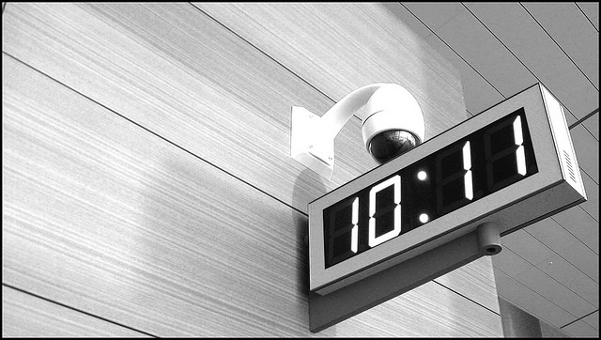
What is counter
Counter is used to count the number.
Counters are created with Flip-flops.

Slide 4
Where we use the counters
Counters are used to do three main functions;
I. Timing
II. Sequencing
III. Counting

Slide 5
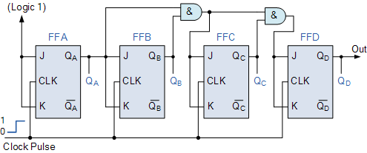
Counter types
There are two types counter;
-Synchronous Counter

Slide 6
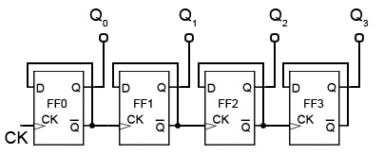
Counter types
-Asynchronous Counter

Slide 7
First project
My assignment is build 3-bit gray code counter with flip-flops,it should count up/down
We use gray code due to one bit change
This reduces the chance of errors
It also allows us to capture errors.

Slide 8
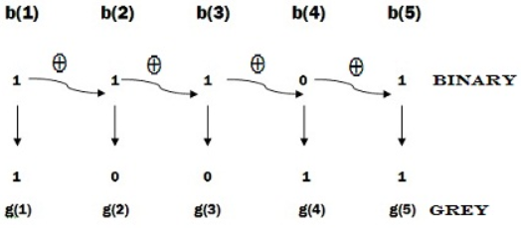
First project
Binary code to gray code
We use here XOR logic.

Slide 9
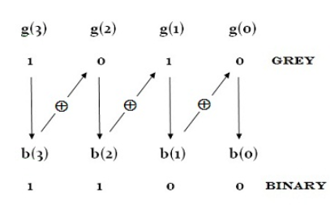
First project
Gray code to binary

Slide 10
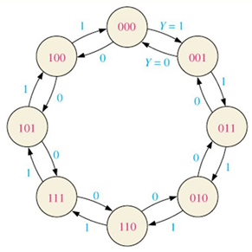
First project
State diagram
Firstly we should prepare state diagram

Slide 11
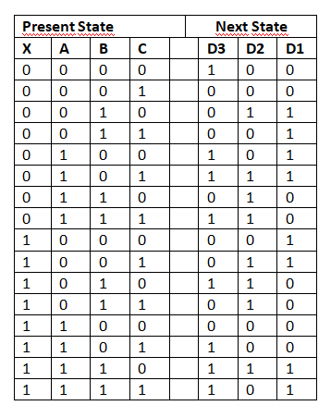
First project
Truth Table

Slide 12
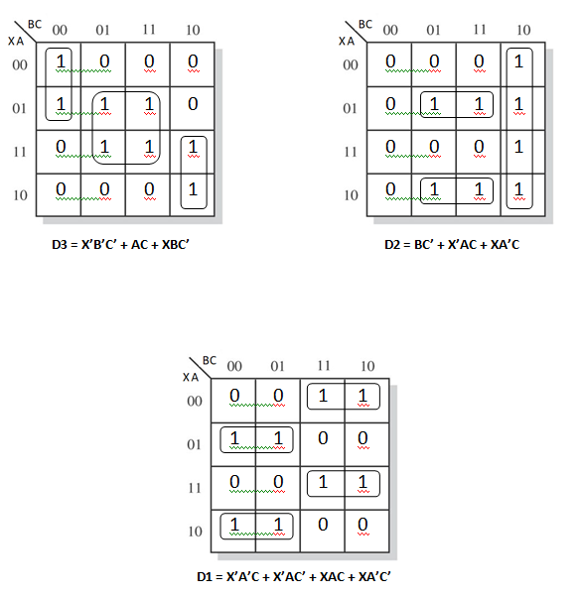
First project
Karnaugh Map

Slide 13
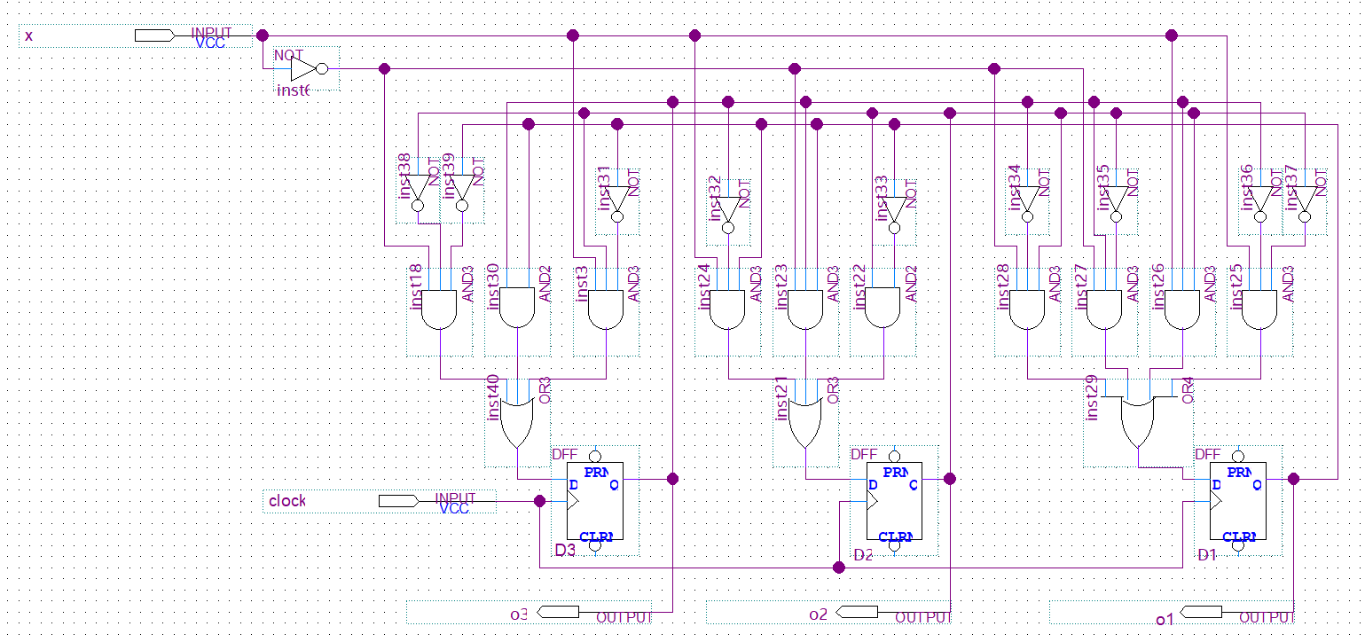
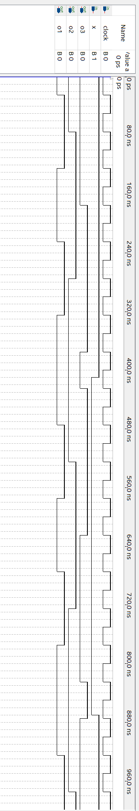
First project

Slide 14
Second project
I designed mod16 counter, it should be up/down count and should have hold function
I used X input for hold function
Output on the flip-flops should be connect 7 segment display

Slide 15
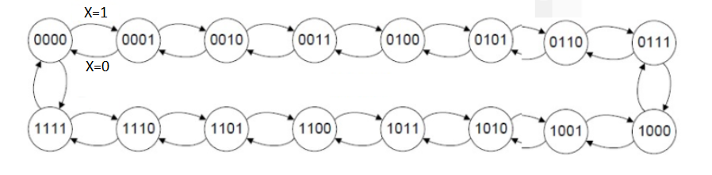
Second project
State diagram

Slide 16
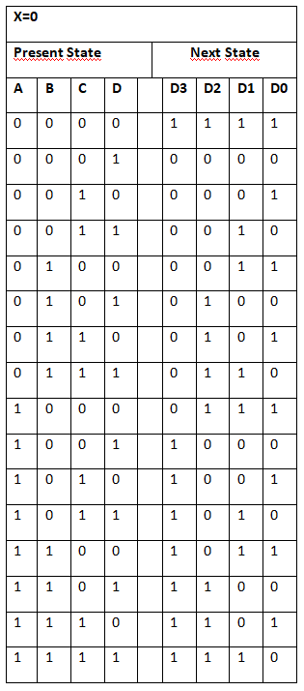
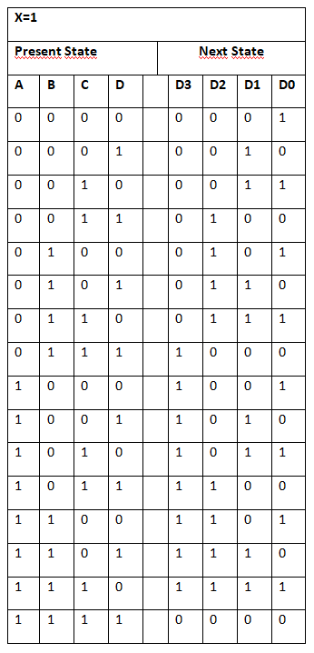
Second project
Truth table

Slide 17
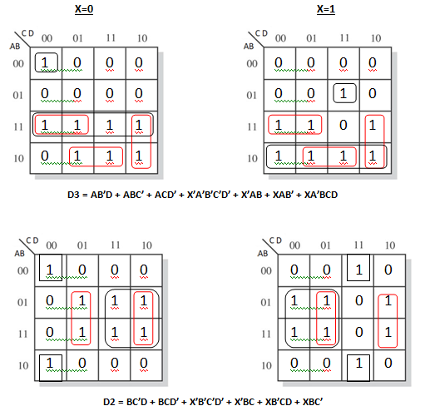
Second project
Karnaugh map

Slide 18
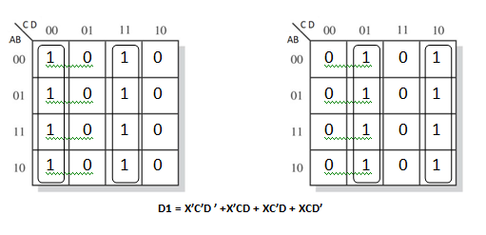
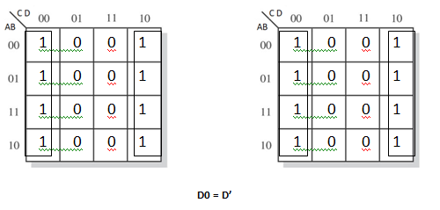
Second project
Karnaugh map

Slide 19
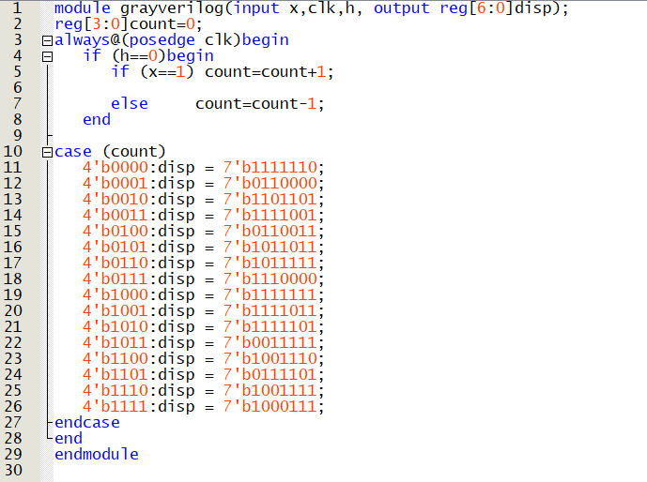
Second project
Verilog
code

Slide 20
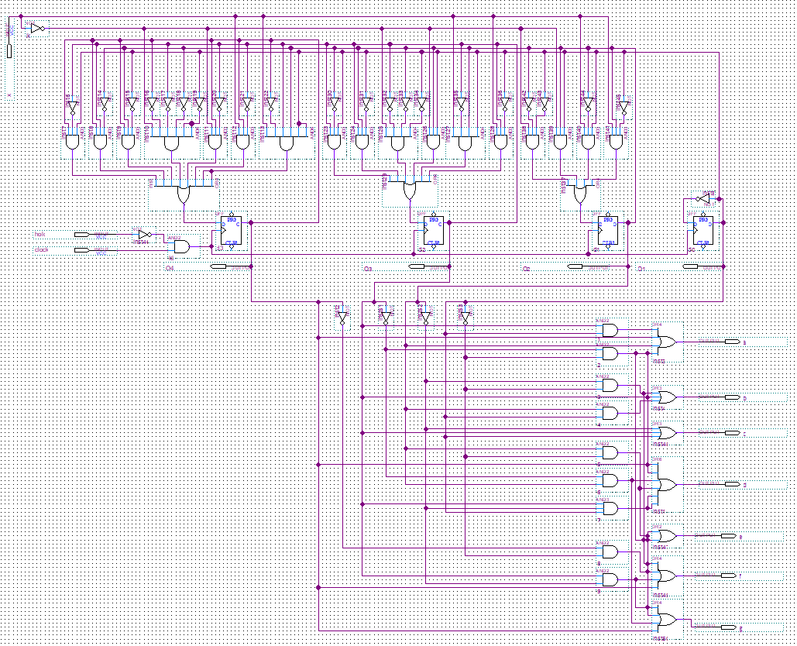
Second project

Slide 21
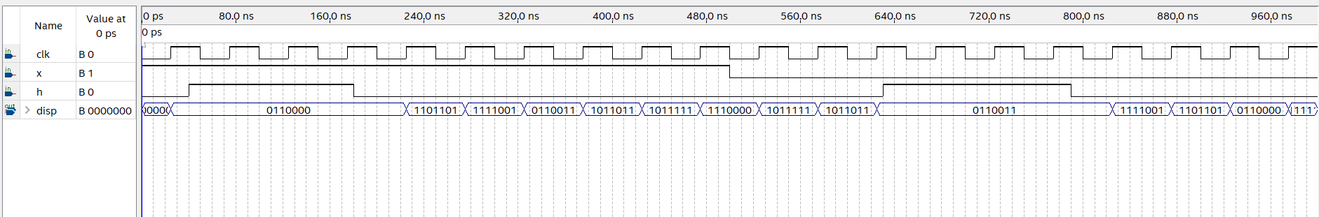
Second project
Analysis

Slide 22
Conclusion
In this projects we learned counters and flip-flops
Converting each other Binary code and Gray code
Solving 5 Karnaugh map

